Slide 1


Perception versus Reality
IMPACT LAB
PRINCIPAL INVESTIGATOR: Chujun Lin
Comparing Subjective Perceptions and Objective Measurements of Attractiveness-Trait Correlations
Junsong Lu
Department of Psychology
University of California San Diego
April 23rd, 2025

Slide 2
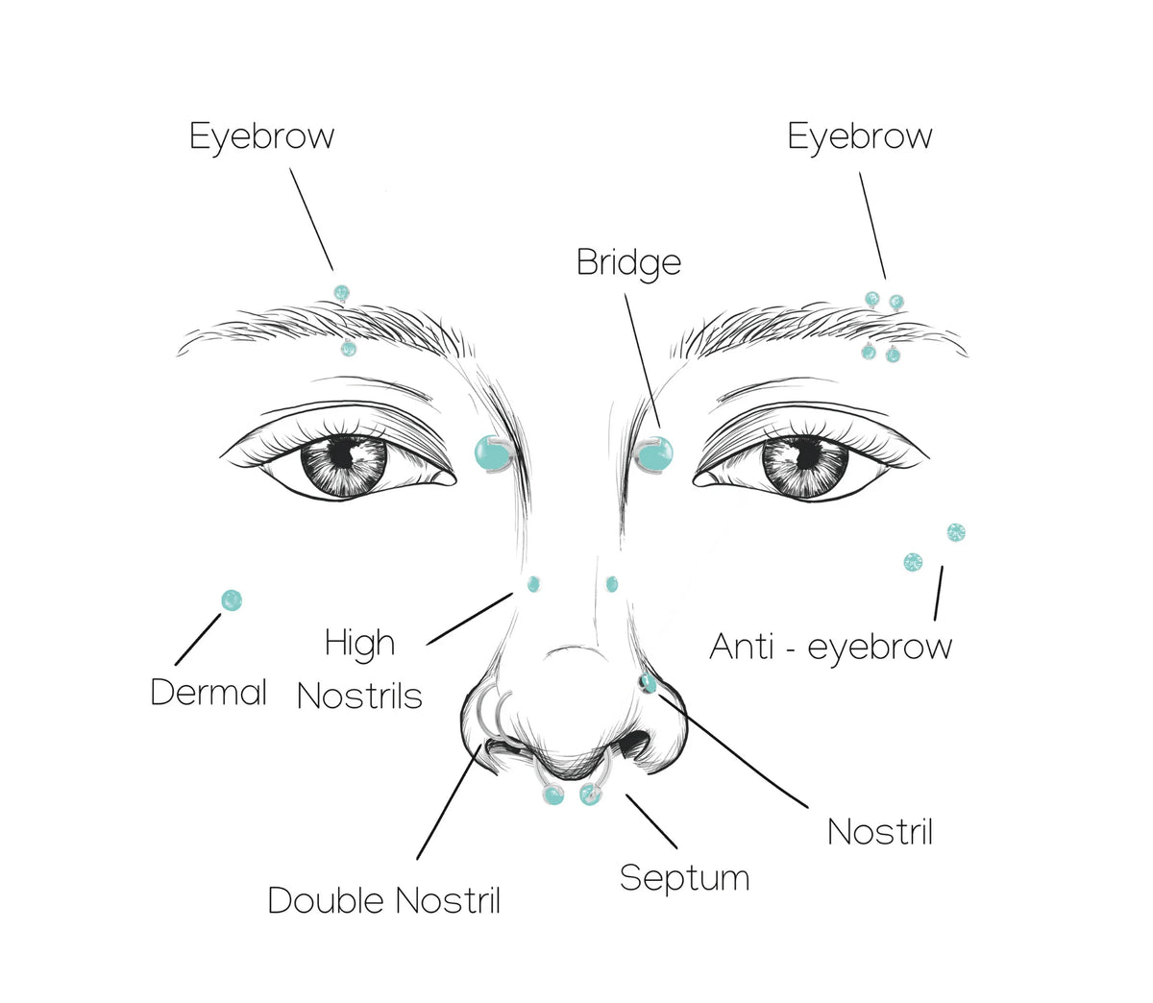
The Beauty-is-Good Effect
Attractive people are attributed as more socially desirable and competent.

Slide 3
Outline
1
Associations Between Attractiveness and Key Traits
Comparing Perceived and Measured Associations
Between Attractiveness and Key Traits
2

Slide 4
The Beauty-is-Good Effect
1
1972
Dion study introduces “what is beautiful is good”, followed
by subsequent explanations
2
1990s
Meta-analyses confirm effect is strong and widespread. Considered as stereotype or bias by researchers
3
2000 to 2020
New theories refuting mere stereotype.
Ongoing debates…

Slide 5


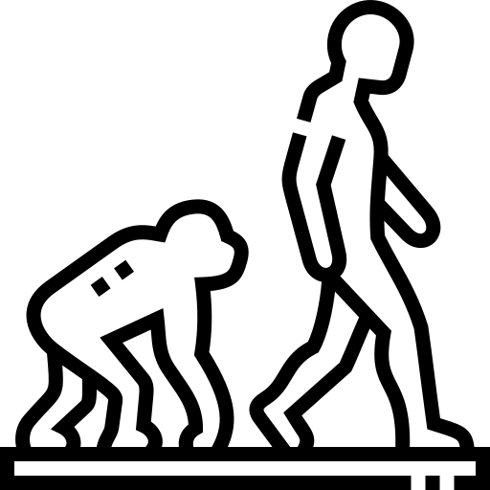
Explanatory Theories (Beauty-is-Good Stereotype)
Economics
Social Psychology
Evolutionary Psychology
Taste-based discrimination in labor market
Status generalization & implicit personality theories
Byproduct of mating
preferences
Notes:
There are multiple explanations for this phenomenon:
Economics sees attractiveness-based judgments as a form of taste-based discrimination, similar to prejudice.
Social Psychology explains it through status generalization theory and implicit personality theory, where attractiveness is unconsciously linked to expectations about performance and traits.
Evolutionary Psychology provides a third angle, suggesting that attractiveness biases are rooted in evolutionary mechanisms, originally evolved for mating and mate selection. According to the evolutionary byproduct account, the beauty advantage is an unintended consequence of biases originally evolved for mating and mate selection. This preference for attractive potential partners is deeply rooted in human psychology and extends into non-mating social interactions

Slide 6
Empirical Evidence (Beauty-is-Good Stereotype)
1
Eagjy et al. (1991)
Effect stronger in social competence domains
2
Feingold (1992)
Little covariance between attractiveness and measured traits (e.g., mental health)
3
Jackson et al. (1995)
Significant association between attractiveness and intelligence in children
Notes:
Although this effect has been considered as stereotype, researchers did not explore the true covariance between A and traits.
Eagly et al. (1991) showed that the beauty-is-good effect is more pronounced in domains like social competence. 尽管认为是stereotype，其认为一部分反应了真实相关，但文章does not directely tested this assumption.
In 1992, however, no associations. But in 1995, there are some evidence

Slide 7
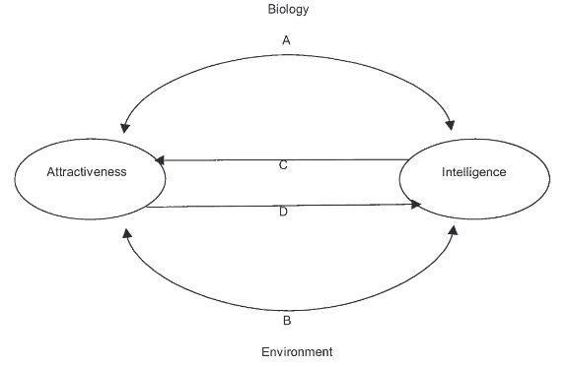
Explanatory Theories (Beauty-is-Good Effect)
A Developmental Model of attractiveness-intelligence relations
Genetic factor
Environmental factor
Self-enhancement
Self-fulfilling prophecy
Zebrowitz et al. (2002)
Notes:
The debate over the discrepancy between perceived and measured associations between attractiveness and traits continues, despite numerous published meta-analyses in the 1990s. Moreover, this topic remains contentious across various traits. In response, new theories have been proposed to explain the covariance between traits and how they are perceived.
Developmental Models Several models have been proposed to explain the attractiveness-intelligence link. For example, Zebrowitz et al. (2002) developed a developmental model, suggesting that genetic and environmental factors both contribute to this association.

Slide 8
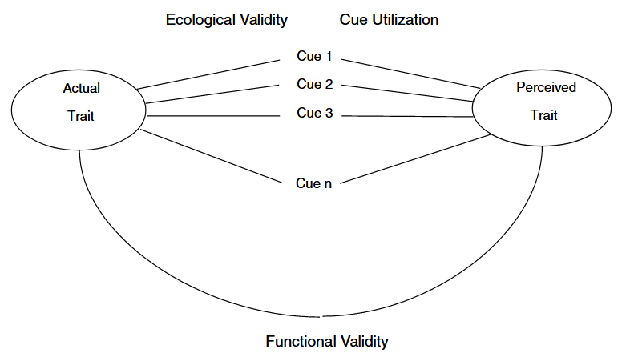
Explanatory Theories (Beauty-is-Good Effect)
Bad Genes Hypothesis
Attractiveness predicts intelligence at lower levels
Face Overgeneralization
People overgeneralize association across full range
Zebrowitz & Rhodes, 2004

Slide 9
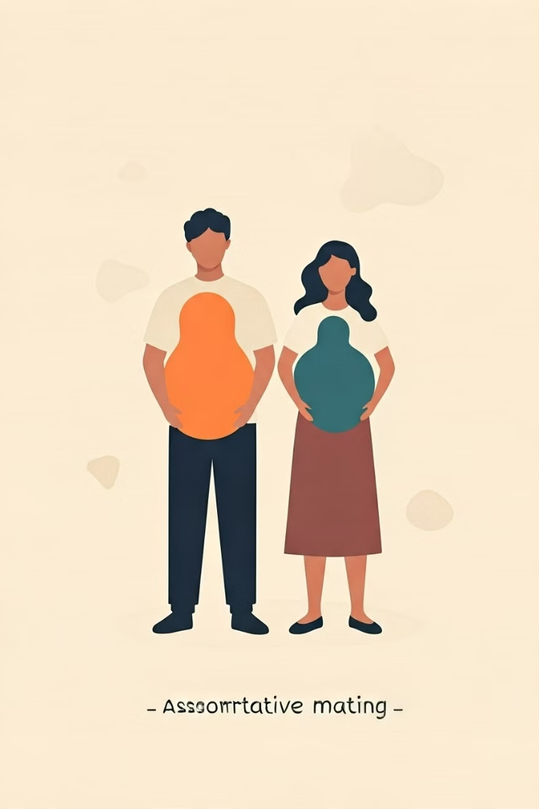
Assortative Mating Hypothesis I
Pairing
Individuals pair based on status-increasing traits
Offspring
Higher in both parental traits
Limitations
Predictive power limited in monogamous societies
(Kanazawa, 2004, 2006)

Slide 10
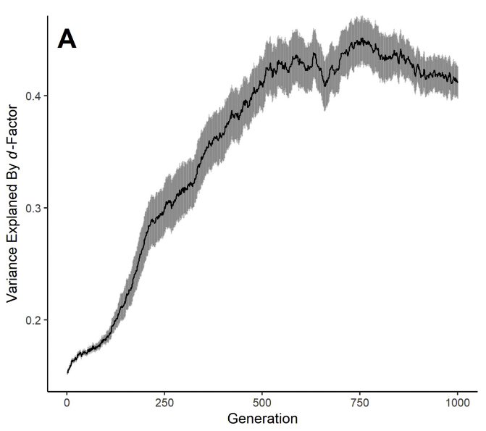

Assortative Mating Hypothesis II
Assortative mating
Mated partners consequently tend to have correlated mate values (Shackelford & Buss, 1997).
Cross-character assortment
assortative mating for mate value creates “cross-character assortment”: correlations between mated partners on otherwise independent traits (Buss & Barnes, 1986).
Conroy-Beam et al., 2019

Slide 11
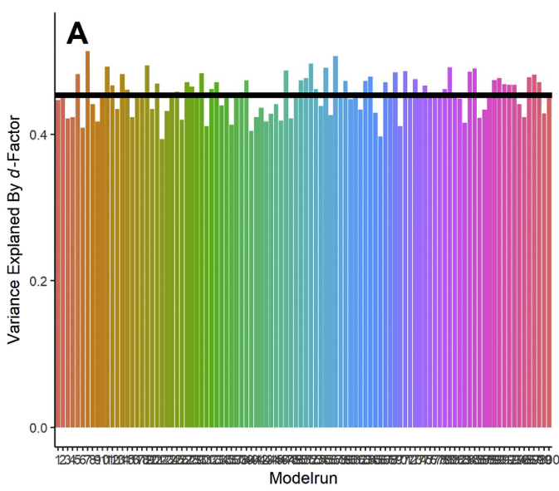
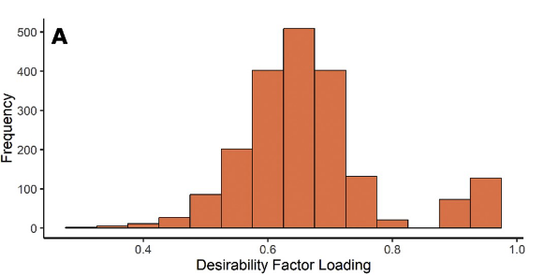
Assortative Mating Hypothesis II
Simulation of the halo effect
Conroy-Beam et al., 2019
Notes:
(1) people mate assortatively for some trait (e.g. physical attractiveness) (2) this trait can be accurately perceived, but (3) perceptions of this trait inspire biased ratings for other traits such that, for instance, physically attractive people are spuriously rated as possessing other desirable characteristics.

Slide 12
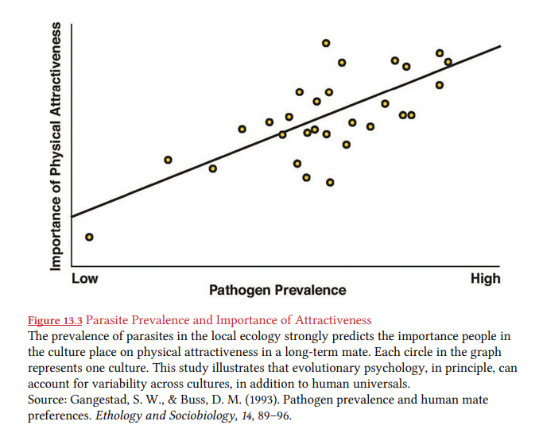
Attractiveness and Health
The Good Genes Hypothesis
Facial symmetry affects attractiveness because it is a certification of overall phenotypic quality and developmental health.
However, adolescent facial attractiveness was unrelated to adolescent health for either males or females, and was not predictive of health at the later times (Kalick et al., 1998).
Thornhill & Gangestad, 1993
Notes:
Facial symmetry is hypothesized to affect positive beauty judgments because symmetry is a certification of overall phenotypic quality and developmental health, which may be importantly influenced by parasites.

Slide 13
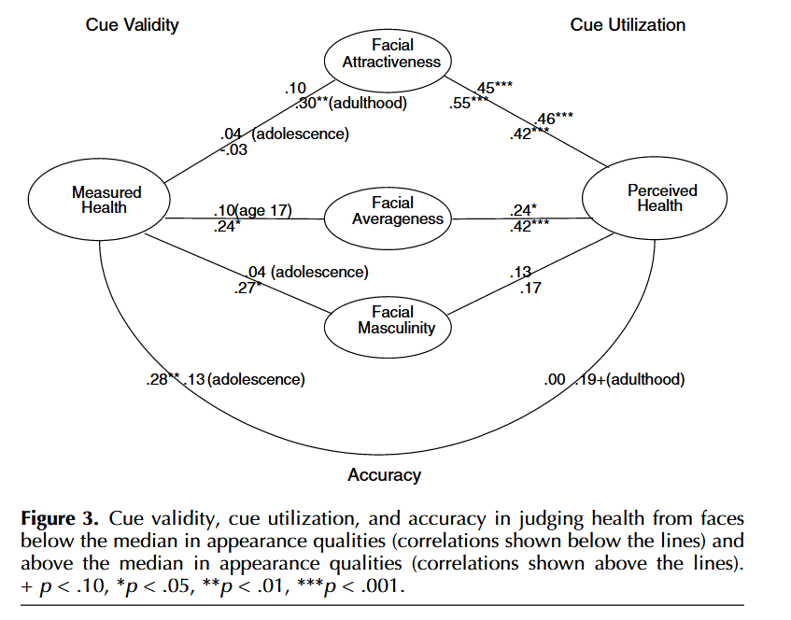
Attractiveness and Health
The Bad Genes Hypothesis
Facial attractiveness provides valid cues to health for faces in the lower but not the upper halves of the distributions of these facial qualities.
But the correlation is insignificant for adolescence (r = -.03)
Zebrowitz & Rhodes, 2004
Notes:
作者没解释为什么adolescence这里不符合预测

Slide 14
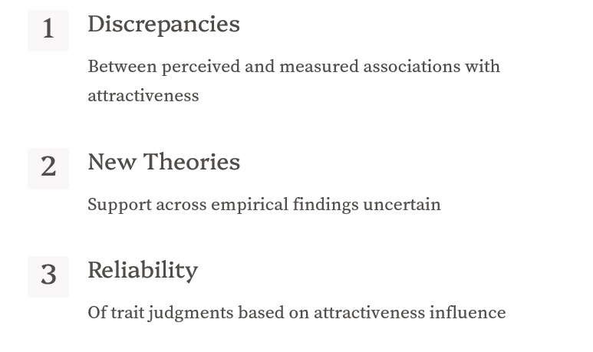
Unsolved Issues
Mitchem et al., 2015

Slide 15
Current Study
The beauty-is-good effect: a genuine phenomenon vs. merely the stereotype?
Incorporate recent findings
Update 30-year-old meta-analyses
Evaluate more recent theories
What are their boundary conditions? Whether predictions generated
by formal models are supported (e.g., reliability)

Slide 16
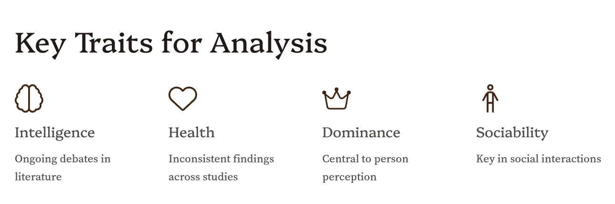


Slide 17

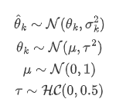
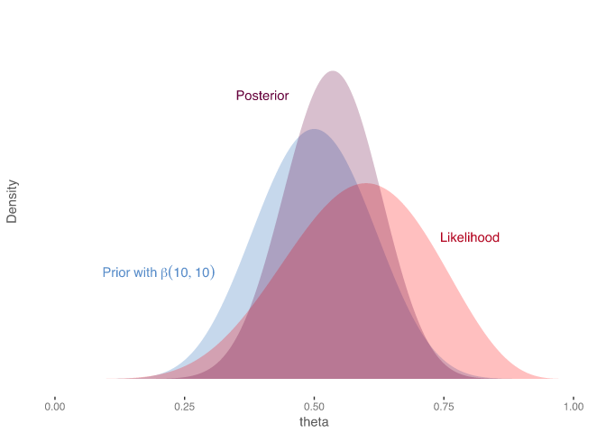
Methods
Bayesian meta-analysis for research synthesis
Posterior distribution for the comparison between perceived and measured traits
Bayesian model comparison (Bayes factor) for testing competing hypothesis

